Slide 1
CAR Calibration Meeting
CAR Review
AP Team
Funny Li, Ravi V, Matthew Kim, J.Y. Lee and Kila Yang
February 2014

Slide 2
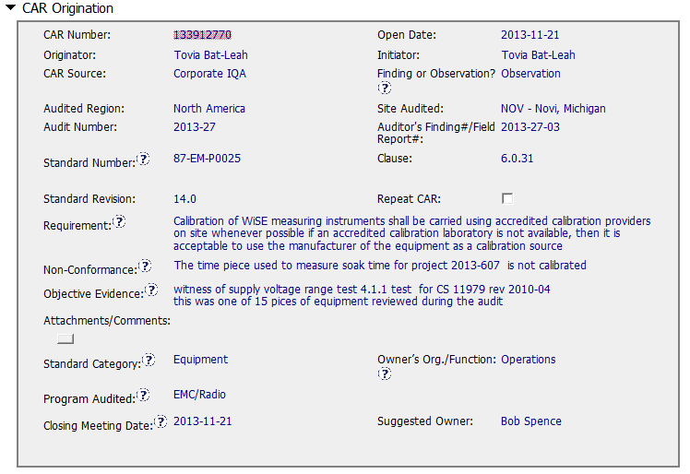
CAR# 133912770
The non-conformance is to use the equipment without calibration.
Notes:
For the CAR# 13392770:
[CAR Review based on 00-QA-S0006 - Corrective Action Request Process]
This CAR is related the lab testing staff used the non-calibration equipment to conduct the test.

Slide 3
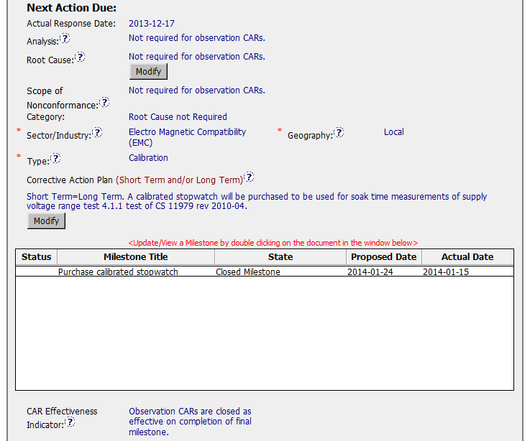
CAR# 133912770 (Corrective Action Plan)
This is an Observation CAR, It’s not required for these three fields.
[Integrity]
(T) Most appropriate ‘category’, ‘type’, ‘geography’ are selected
[Competitiveness]
(C) – Ensuring the ‘Category’ is “Root Cause not Required” for this observation CAR.
(C) – Corrective actions fix the objective evidence, do not go beyond fixing the objective evidence for this observation CAR.
Notes:
For the CAR# 13392770:
This is an Observation CAR, It’s not required for Analysis and Root Cause description.

Slide 4
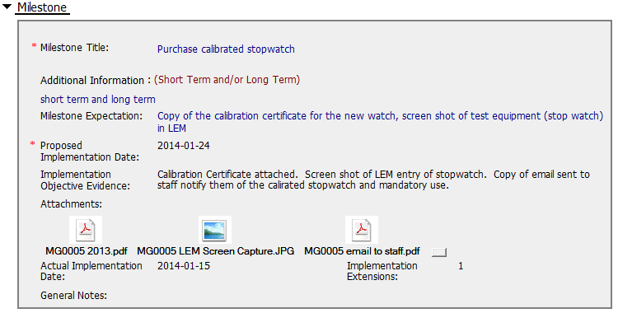
CAR# 133912770 (Milestone)
Equipment Calibration Certificate and LEM screen shot are attached.
Email reminder and prevent the similar issue occurred.

Slide 5
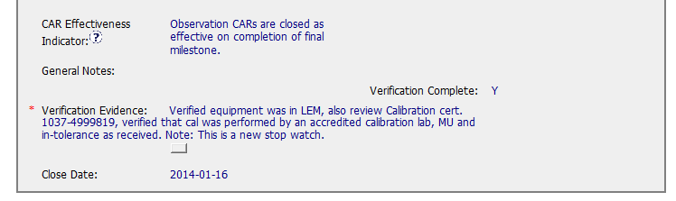
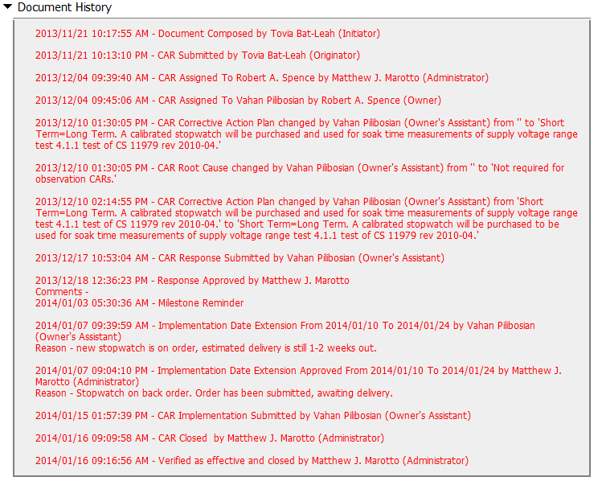
CAR# 133912770 (Milestone)
[Competitiveness]
(P) Providing the sufficient information for verification.
[Integrity]
(C) Extensions are within requirement (<30 days, 3 or less)
(T) Acts on CARs within required timeframe

